Slide 1
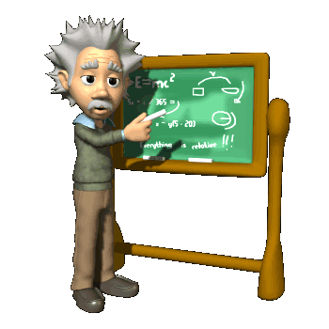
Chapter 3 Applications of Differentiation
In this Chapter, we will know some important concepts.
Newton’s Method (牛顿法)
L’Hopital’s Rule (洛必达法则)
Optimization (最优化)
Increasing and Decreasing Functions
Concavity and the Second Derivative Test (凹凸性和二阶导检验)

Slide 2
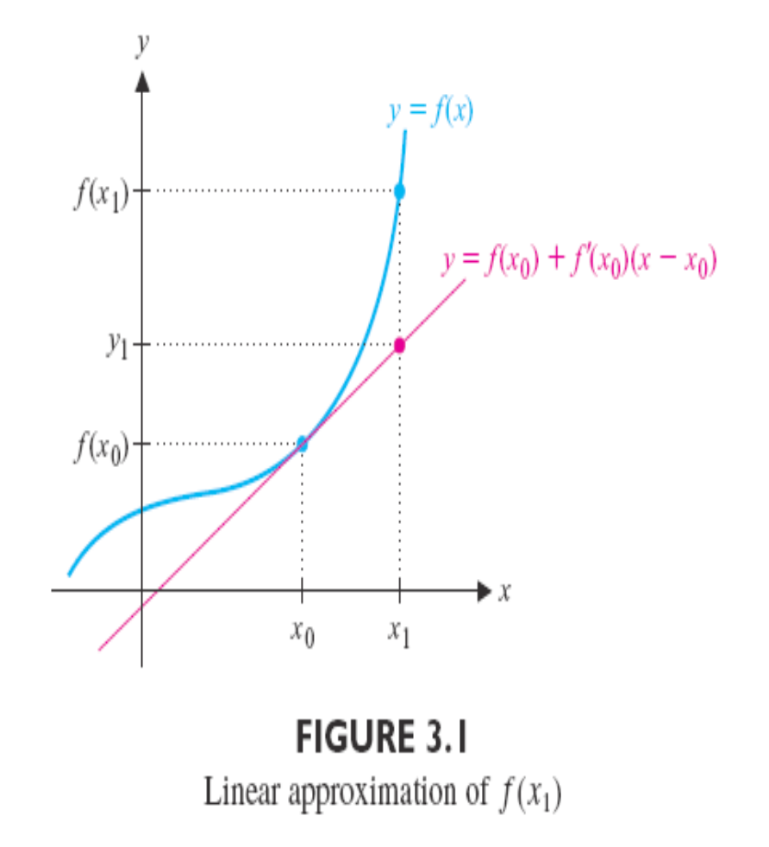




Section 3.1 Linear Approximations and Newton’s Method
Linear Approximations (线性近似)
Suppose we wanted to find an approximation for , where is unknown. For some “close” to , we know the value .

Slide 3
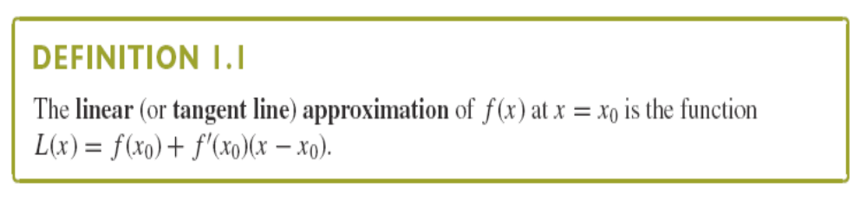
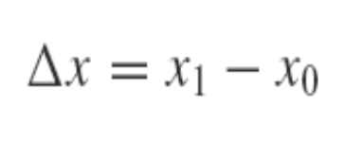
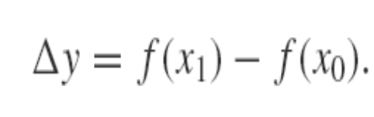
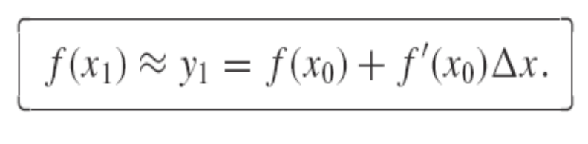
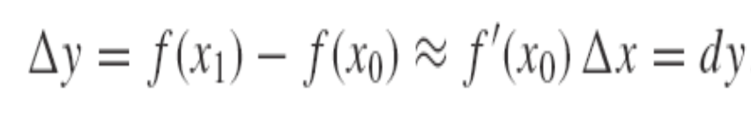
We define △x and △y by
and
Using this notation, we have the approximation
So we have

Slide 4
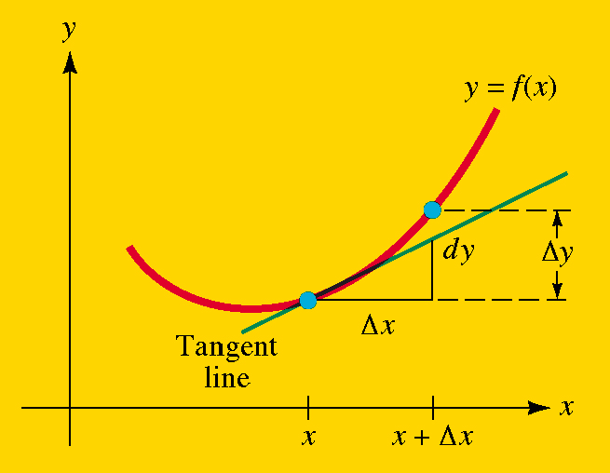
Differentials(微分): The differential of x is dx=△x, and if y=f(x) is a differentiable function of x, then dy=f’(x)dx is the differential of y.

Slide 5
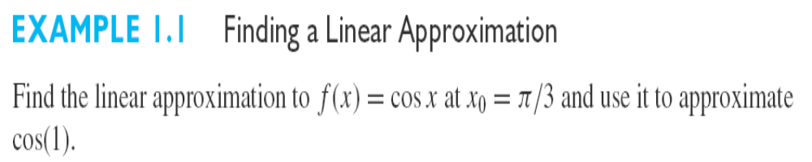
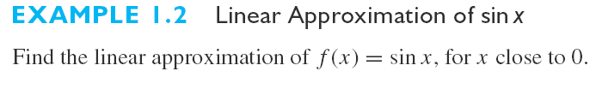
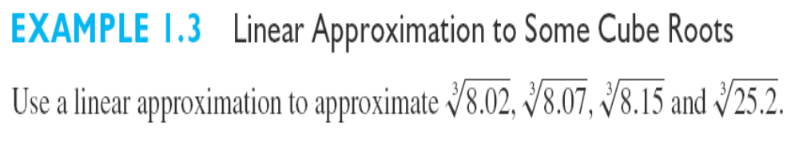

Slide 6
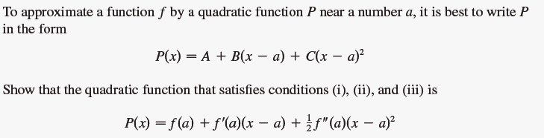
Taylor Polynomials Approximation

Slide 7
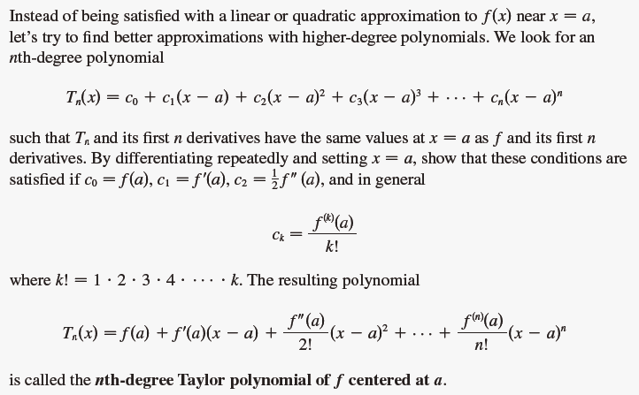

Slide 8
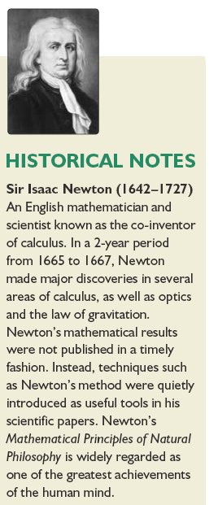
Newton’s Method (牛顿法) (Newton-Raphson method)
We now return to the question of finding zeros of a function.
Here, we explore a method that is usually much more efficient than bisection method.
The question is
how are we to find them (roots of equation or zeros of the function f) ?

Slide 9
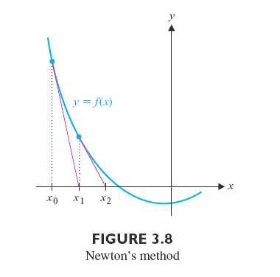

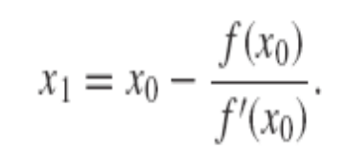


To find approximate solutions to f(x)=0.
a. We first make an initial guess, denoted , of the location of a solution.
b. We get
c. Using as our new guess, we should produce a further improved approximation.

Slide 10
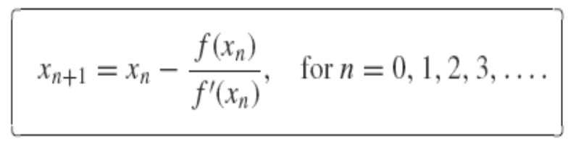
d. In this way, we generate a sequence of successive approximations determined by
The approximate solution will be generated until convergence.
Remark: Newton’s method does not always work. Newton’s method is sensitive to the initial guess.

Slide 11
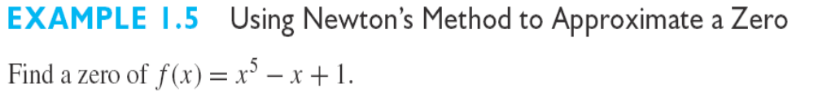


Slide 12
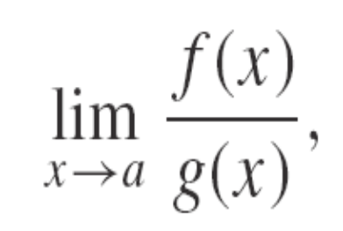
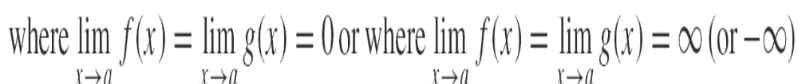
Section 3.2 Indeterminate Forms and L’Hopital’s Rule （不定式与洛必达法则）
We reconsider the problem of computing limits as follows
We call this form as indeterminate forms.

Slide 13
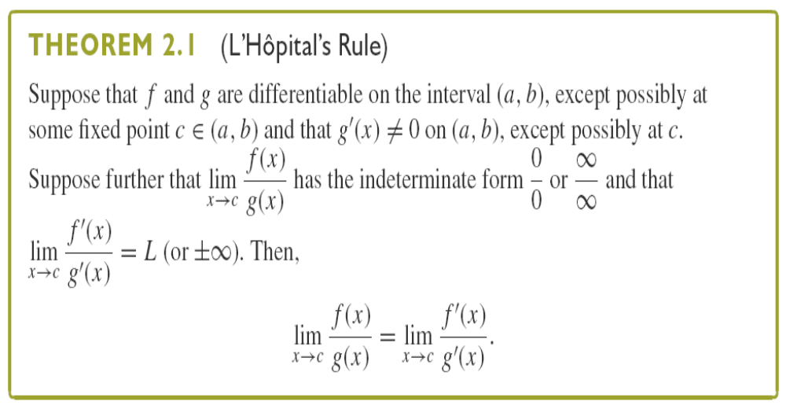
L’Hopital’s Rule (洛必达法则)

Slide 14
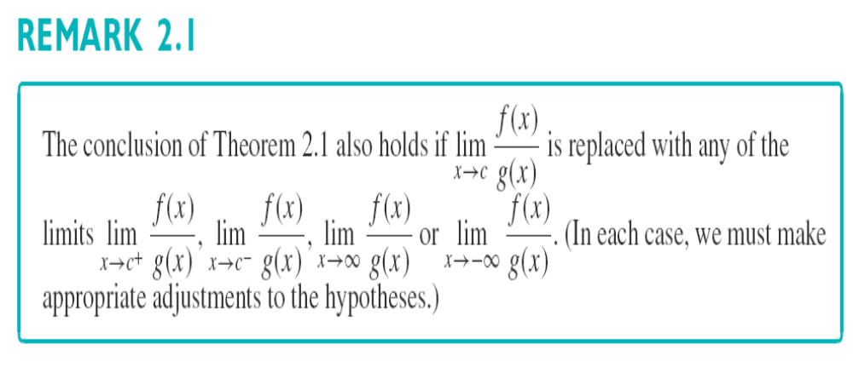

Slide 15
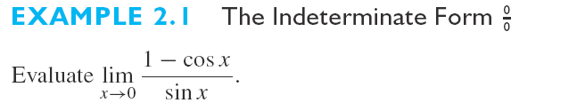
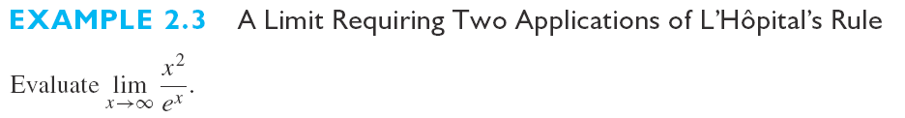
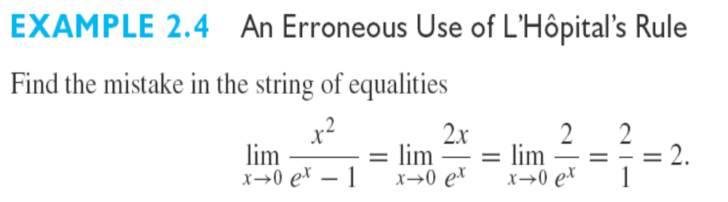

Slide 16
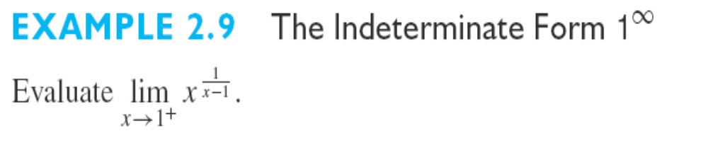
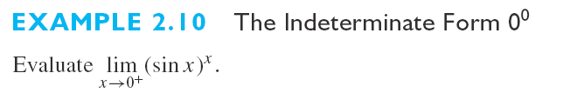
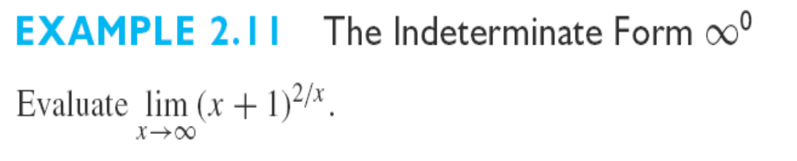

Slide 17
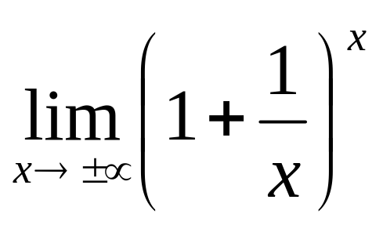
Exercise Question：

Slide 18
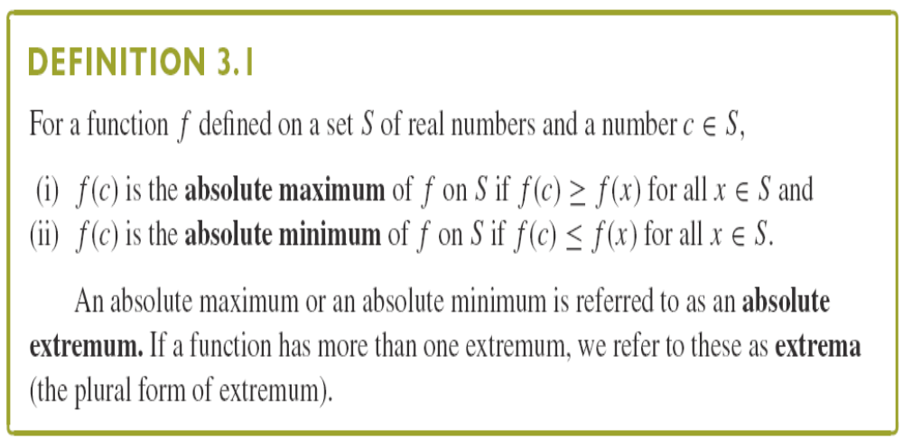
Section 3.3 Maximum and Minimum Values(最大和最小值)

Slide 19
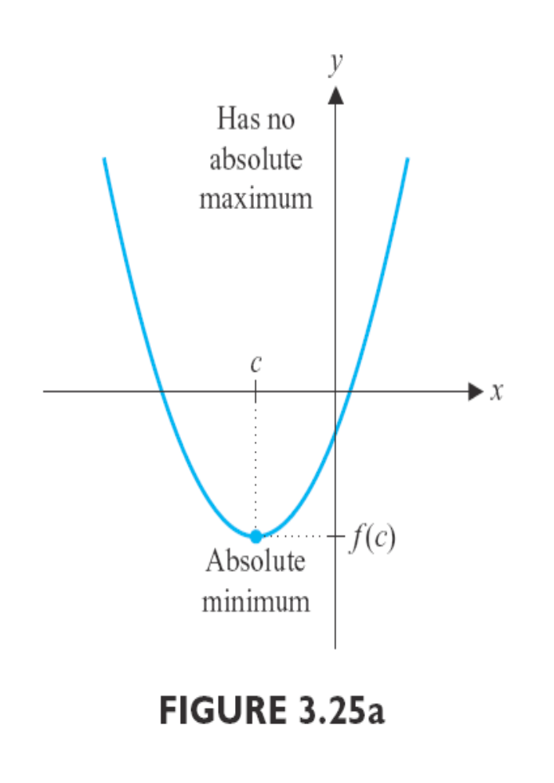
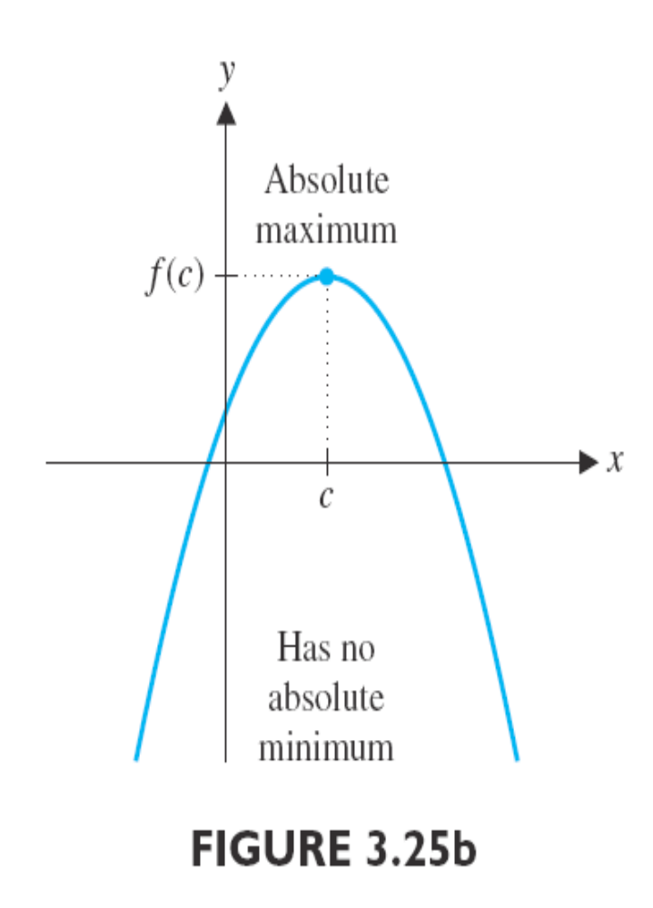

Slide 20
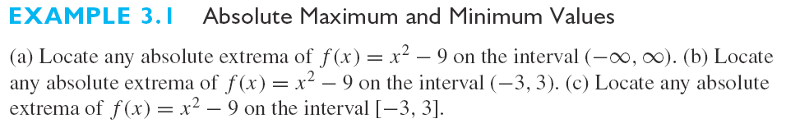
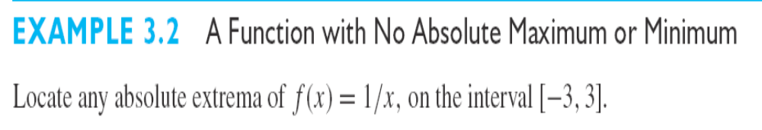
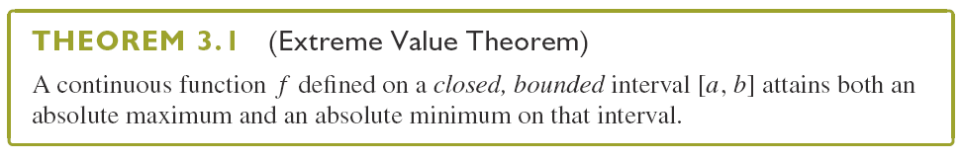
（极值定理）

Slide 21
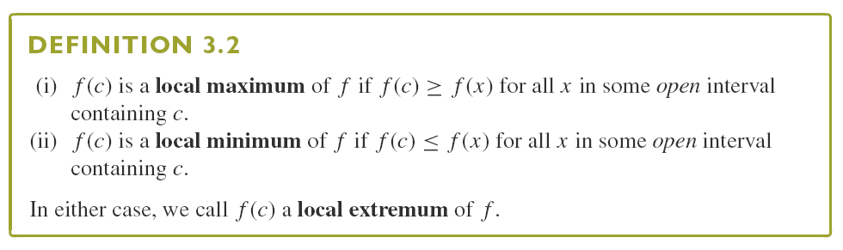
Our objective is to determine how to locate the absolute extrema of a given function. Before we do this, we need to consider an additional type of extremum.
(局部极值)

Slide 22
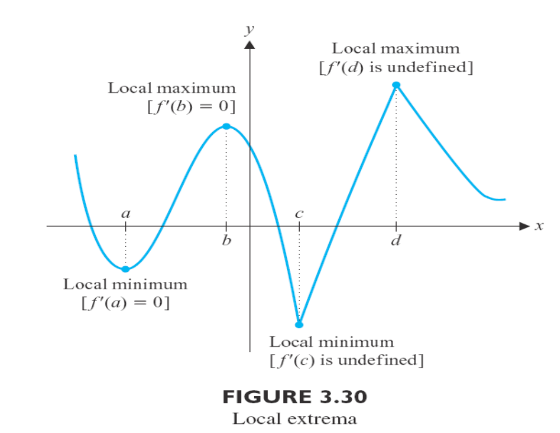

Slide 23
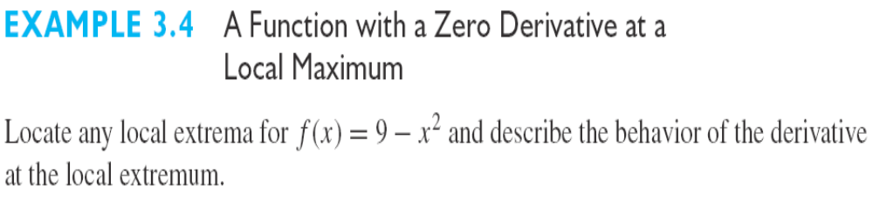
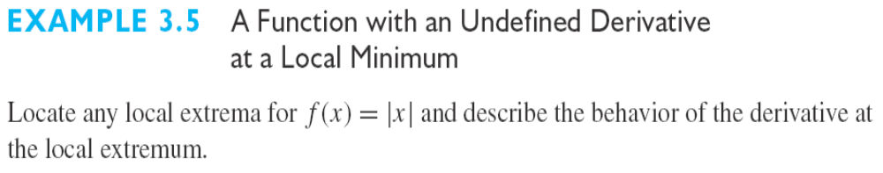
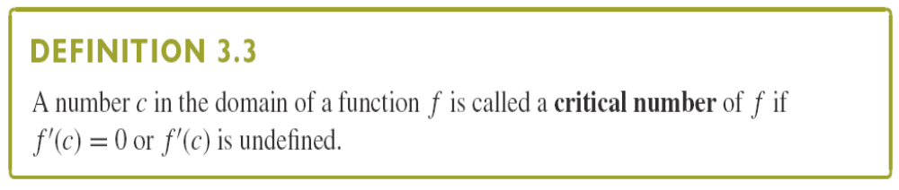
（关键点）
Relative (local) extrema can only occur at critical numbers!

Slide 24
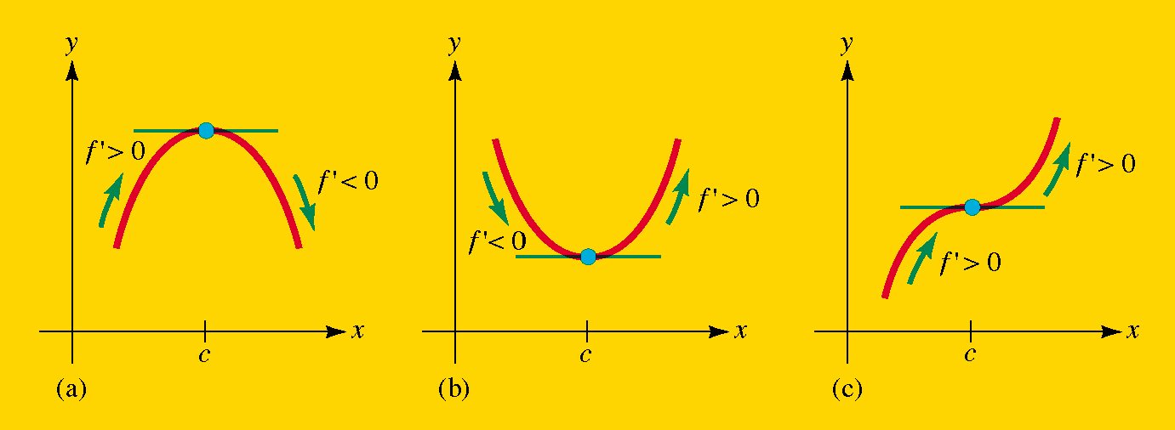
Not all critical points correspond to relative（local） extrema!
Figure. Three critical points where f’(x) = 0: (a) relative maximum, (b) relative minimum (c) not a relative extremum.
Section 3.1 Relative Extrema

Slide 25
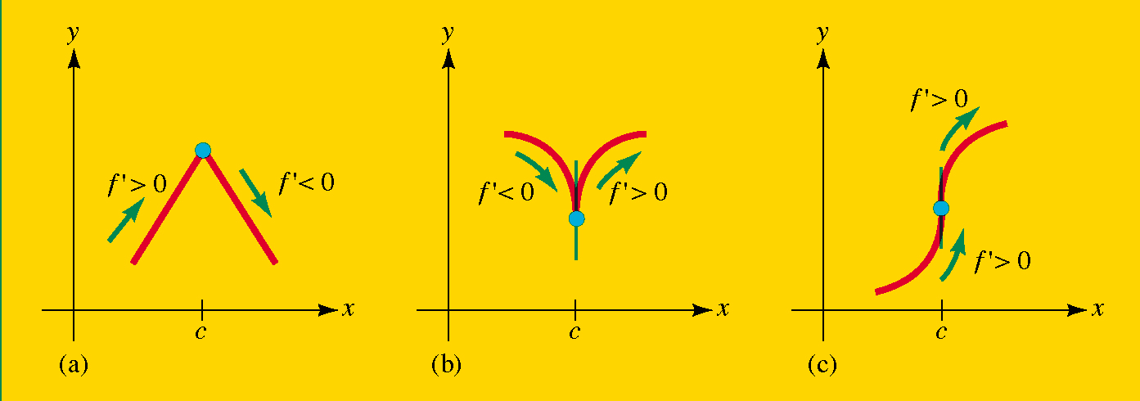
Not all critical points correspond to relative (local) extrema!
Figure Three critical points where f’(x) is undefined:(a) relative maximum, (b) relative minimum (c) not a relative extremum.
Section 3.1 Relative Extrema

Slide 26
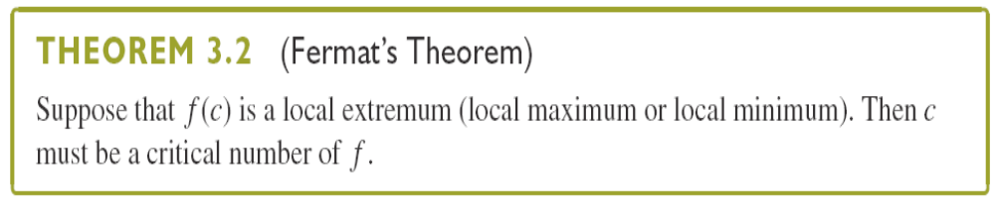
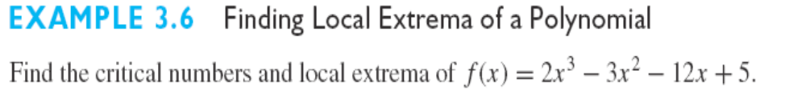
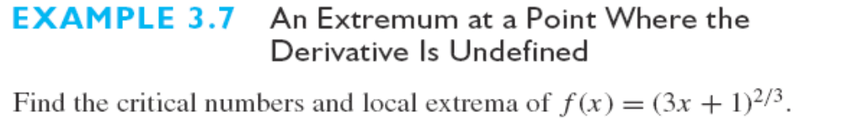
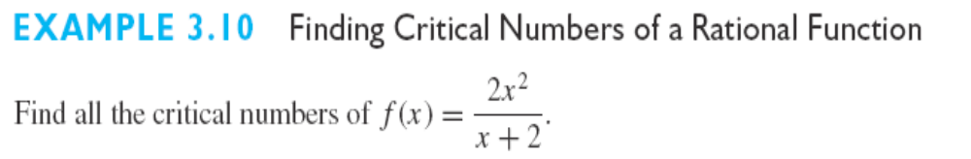
(费马定理)

Slide 27
